Slide 1


LAUNCHING AN ONLINE NURSERY
Apna Bageecha
Never Desert your surroundings.

Slide 2
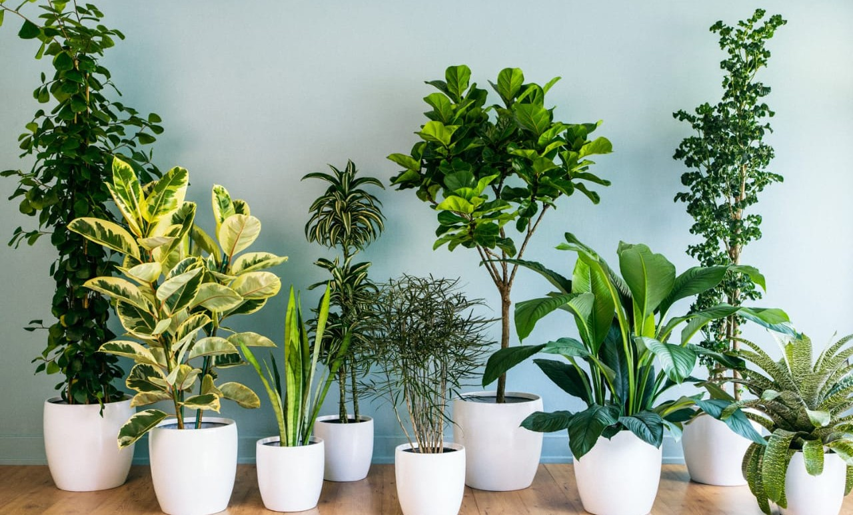

PRESENTATION FLOW
About:Apna Bageecha User Journey
Market Research
Goals and future scope Software Used Creators
Lets's talk
What to Expect

Slide 3
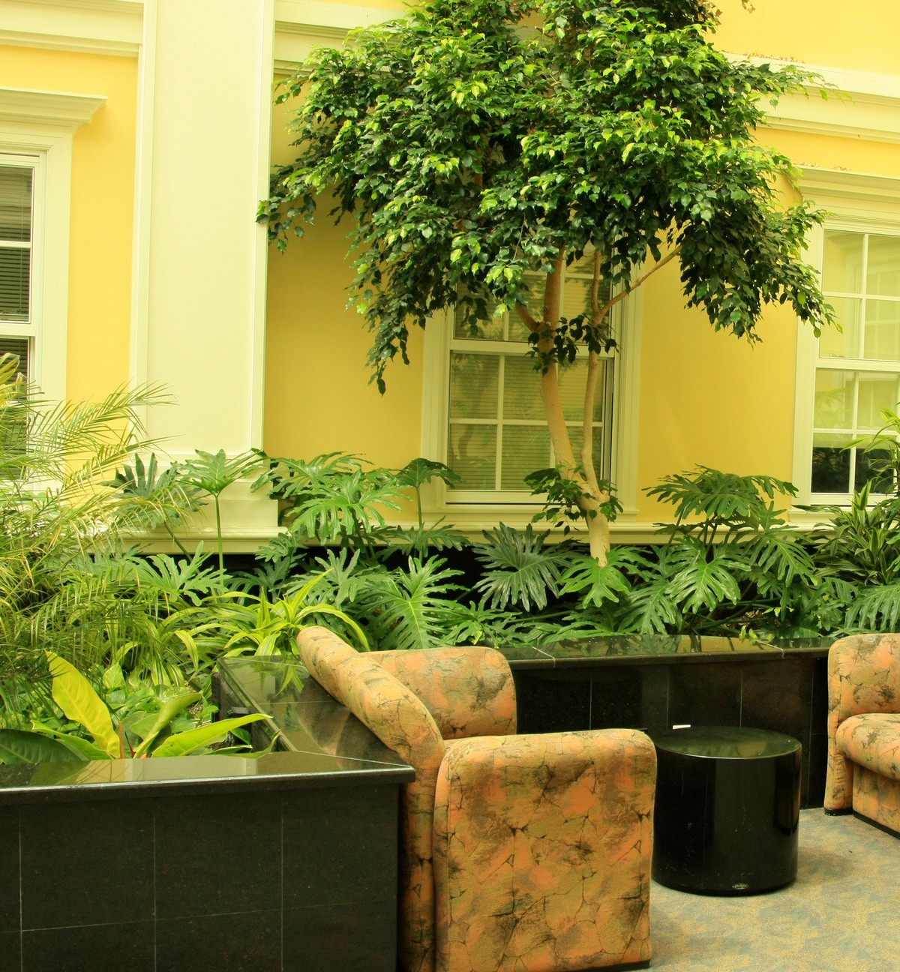
WANT TO GIVE
AESTHETIC TOUCH TO YOUR HOME?
We got you !
With our website you can now order plants right from the comfort of your home in just few simple steps.

Slide 4
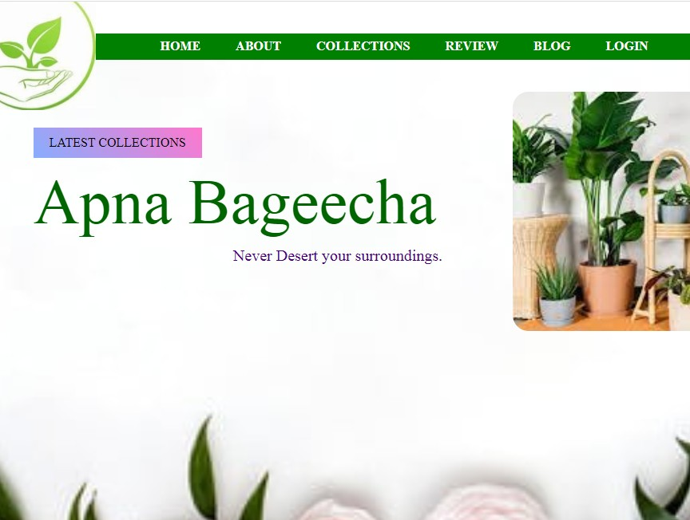
Introducing Apna
Bageecha
WHAT WE DO!
Our site furnishes you with a wide range of plants that provides an aesthetic look to your home.

Slide 5


LOGIN
Fill the username and password.
ORDER AND PAY
Fill the basic details about you and the order.
User Journey
WAIT FOR DELIVERY
Wait for few days your order will be delieverd soon.

Slide 6

40
30
20
Market Survey
MOTIVATION FOR BUYING
10
It adds a green touch to your home and you are lending a helping hand towards environment conservation.
0
Item 1
Item 2
Item 3
Item 4

Slide 7

OUR WEBSITE WILL TURN OUT TO BE THE ULTIMATE SOLUTION TO ALL THE FLORAL NEEDS FOR OUR
CLIENTS TO ENRICH AND TRANSFORM OUR CLIENT' S ENVIRONMENT
WE WILL INTRODUCE SEEDS AND MANY MORE OTHER VARIETY OF PLANTS FOR ALL OUR
CUSTOMERS
WE WILL INCLUDE A UNIQUE ELEMENT OF BLOG
Goals
SECTION IN OUR WEBSITE WHICH APPRISES ALL
OUR WEBSITE USERS TO KNOW HOW TO INSTALL
AND TAKE CARE OF PLANTS AT HOME?

Slide 8

HTML
HTML is the standard markup language for Web pages.
CSS
CSS is the language we use to style an HTML document.
PHP
PHP is a general-purpose scripting language that is especially suited to web development.
MYSQL
SQL is a standard language for accessing and manipulating databases.
Software
Used

Slide 9

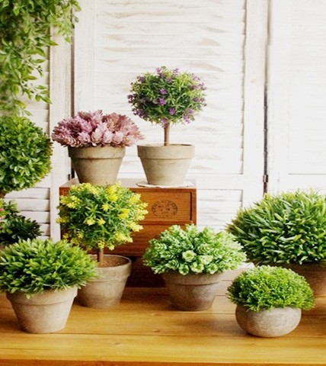
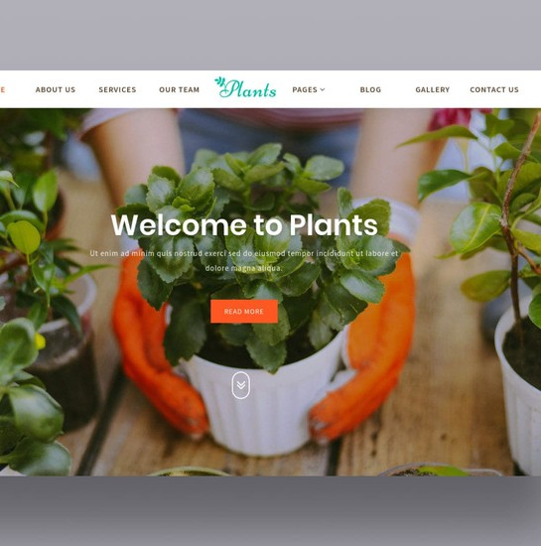

CREATORS:
TRIPTA
20BCS1534
RIJUL SHAKYA 20BCS1580

Slide 10

Let's Talk
MAIN BRANCH ADDRESS
STREET NO 4, RAJLOK PHASE-1,HARIDWAR
PHONE NUMBER
01334-239060
EMAIL ADDRESS
ayushyaduvanshi14@gmail.com

